Slide 1
Machine Learning Workshop: Naïve Bayes Classifier

Slide 2
Naïve Bayes Classifier
The Naïve Bayes classifier is a simple probabilistic classifier which is based on Bayes theorem but with strong assumptions regarding independence.
Applications in email filtering, spam detection, and document categorization.
Often outperformed by other techniques,
he naïve design and
oversimplified assumptions
Still, can perform well in many complex real-world problems.

Slide 3
Bayes Theorem

Slide 4
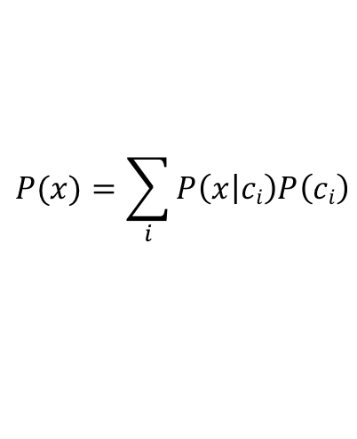
Bayes Theorem - Classification
Conditional independence
$$P(x)=\sum_{i}{P\left(x | ci\right)P\left(ci\right)}$$

Slide 5
Likelihood
Gaussian Distribution

Slide 6
Bayes Theorem - Classification
The fundamental idea of Bayesian inference is to become “less wrong” with more data.
We have an initial belief, known as a prior, which we update as we gain additional information.
https://towardsdatascience.com/bayes-rule-applied-75965e4482ff
https://scikit-learn.org/stable/modules/naive_bayes.html

Slide 7
Decision Trees and Random Forest
https://www.analyticsvidhya.com/blog/2016/04/tree-based-algorithms-complete-tutorial-scratch-in-python/
https://towardsdatascience.com/understanding-random-forest-58381e0602d2

Slide 8
Decision Trees
In this technique, we split the population or sample into two or more homogeneous sets (or sub-populations) based on most significant splitter / differentiator in input variables.

Slide 9
Decision Trees
How to split the data at the nodes?
What feature will allow me to split the observations at hand in a way that the resulting groups are as different from each other as possible (and the members of each resulting subgroup are as similar to each other as possible)?
To construct the decision tree,
Information content of each feature is measured
Features with high information content are selected

Slide 10
Decision Tree example: Play cricket?
Let’s say we have a sample of 30 students with three variables Gender (Boy/ Girl), Class( IX/ X) and Height (5 to 6 ft).
15 out of these 30 play cricket in leisure time. We want to create a model to predict who will play cricket during leisure period.
We need to segregate students who play cricket in their leisure time based on highly significant input variable among all three

Slide 11
Decision Tree example: Play cricket?

Slide 12
Decision Tree metrics: Gini impurity
Gini says, if we select two items from a population at random then they must be of same class and probability for this is 1 if population is pure.
It works with categorical target variable “Success” or “Failure”.
It performs only Binary splits
Higher the value of Gini higher the homogeneity.
CART (Classification and Regression Tree) uses Gini method to create binary splits

Slide 13
Decision Tree metrics: Gini impurity
Above, the Gini score for Split on Gender is higher than Split on Class, hence, the node split will take place on Gender.

Slide 14
Decision Tree metrics: Information Gain
which node can be described easily?
C requires less information as all values are similar. On the other hand, B requires more information to describe it and A requires the maximum information.
In other words, we can say that C is a Pure node, B is less Impure and A is more impure.
Less impure node requires less information to describe it. And, more impure node requires more information.
Information theory is a measure to define this degree of disorganization in a system known as Entropy.
If the sample is completely homogeneous, then the entropy is zero and if the sample is an equally divided (50% – 50%), it has entropy of one.

Slide 15
Information Gain: Entropy
Entropy for Split on Gender is lower, so the tree will split on Gender. We can derive information gain from entropy as 1- Entropy.

Slide 16
Types of Decision Trees
ID3
C4.5
CART

Slide 17
Random Forest
Random forest, like its name implies, consists of a large number of individual decision trees that operate as an ensemble.
Each individual tree in the random forest spits out a class prediction and the class with the most votes becomes our model’s prediction.
A large number of relatively uncorrelated models (trees) operating as a committee will outperform any of the individual constituent models.

Slide 18
Random Forest
Bagging (Bootstrap Aggregation): Instead of the original training data, we take a random sample of size N with replacement. For example, if our training data was [1, 2, 3, 4, 5, 6] then we might give one of our trees the following list [1, 2, 2, 3, 6, 6].
Feature Randomness — Each tree in a random forest can pick only from a random subset of features.

